Slide 1

Powered by: KERNEL’S Team
م/ احمد وائل - م/ مصطفى خميس

Slide 2
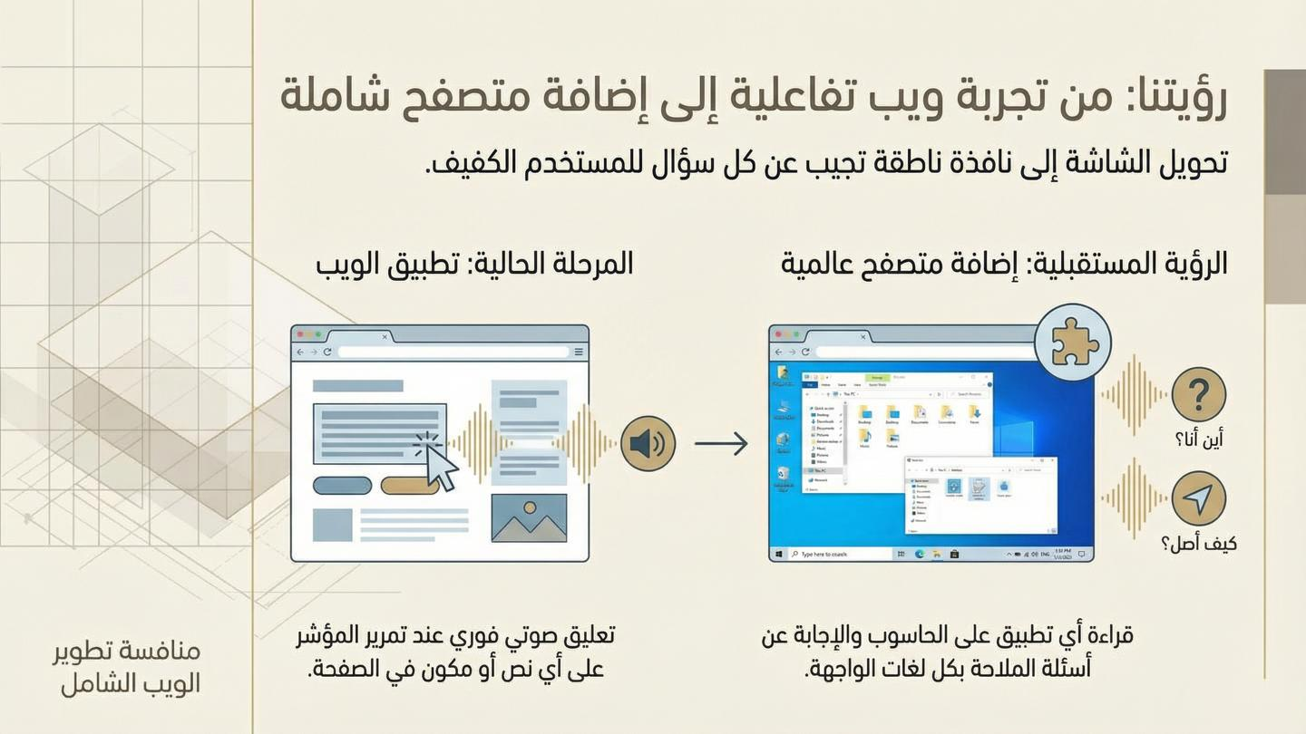

Slide 3
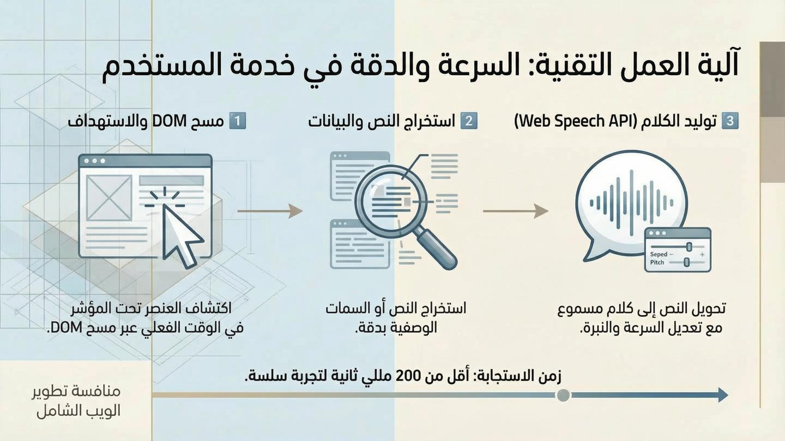

Slide 4
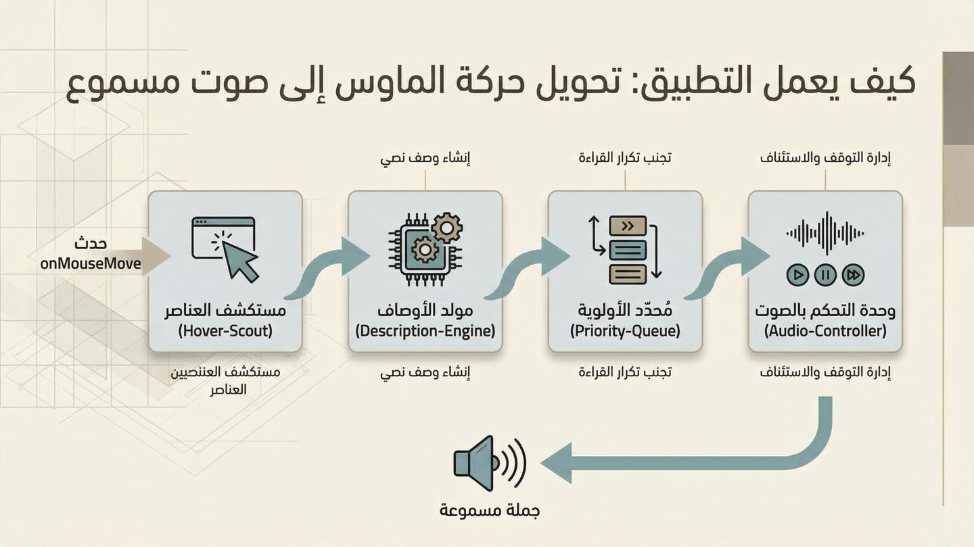

Slide 5
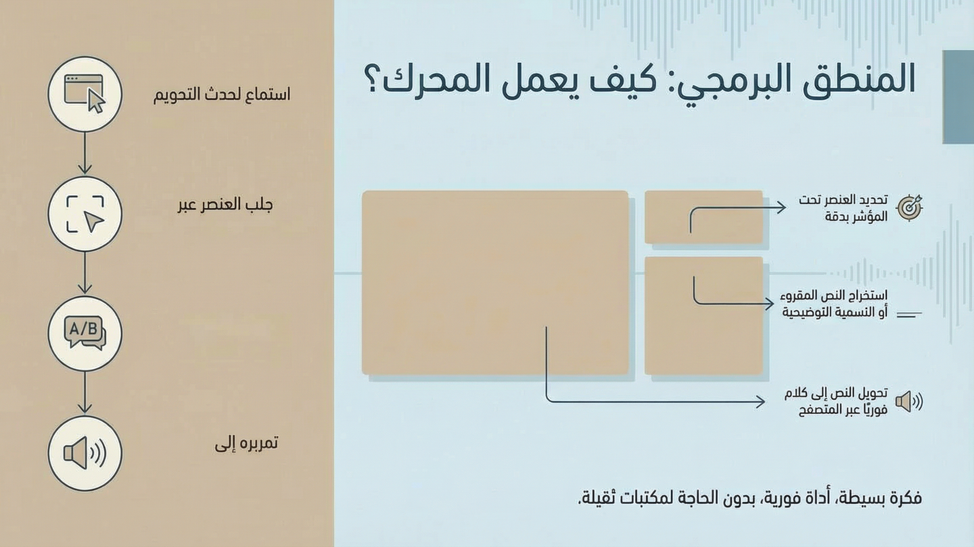
<script>
document.elementFromPoint
document.addEventListener("mouseup", function () {
let selectedText = window.getSelection().toString().trim();
if (selectedText.length > 0){
T
// Speak the selected text
let speech = new SpeechSynthesisUtterance(selectedText);
speech.lang = "en-US"; // Change language if needed
window.speechSynthesis.speak(speech);
}
aria-labelaljaiwl textContent gl
});
</script>
.speak.olw

Slide 6
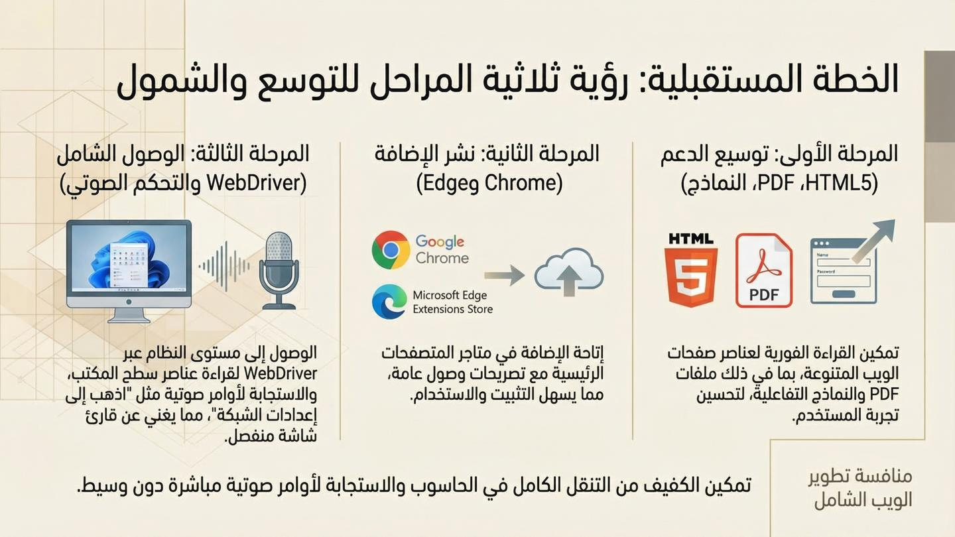

Slide 7
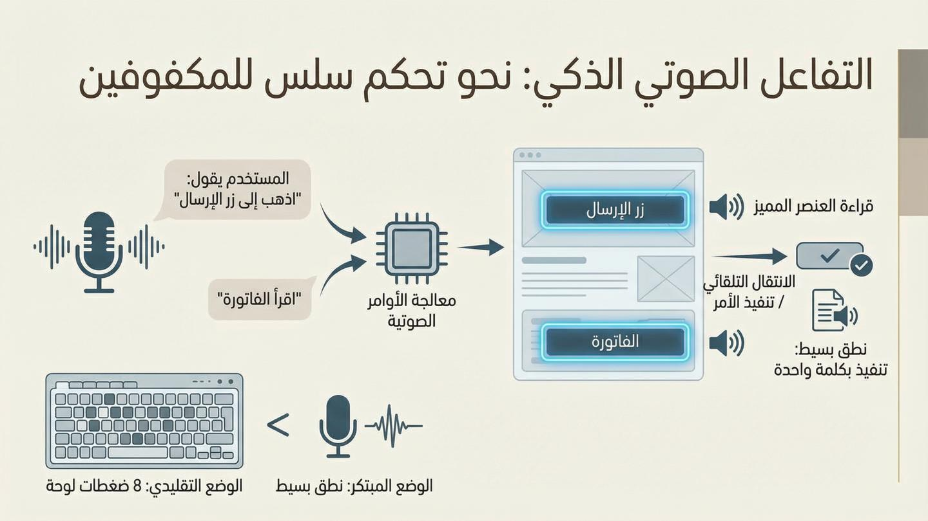

Slide 8
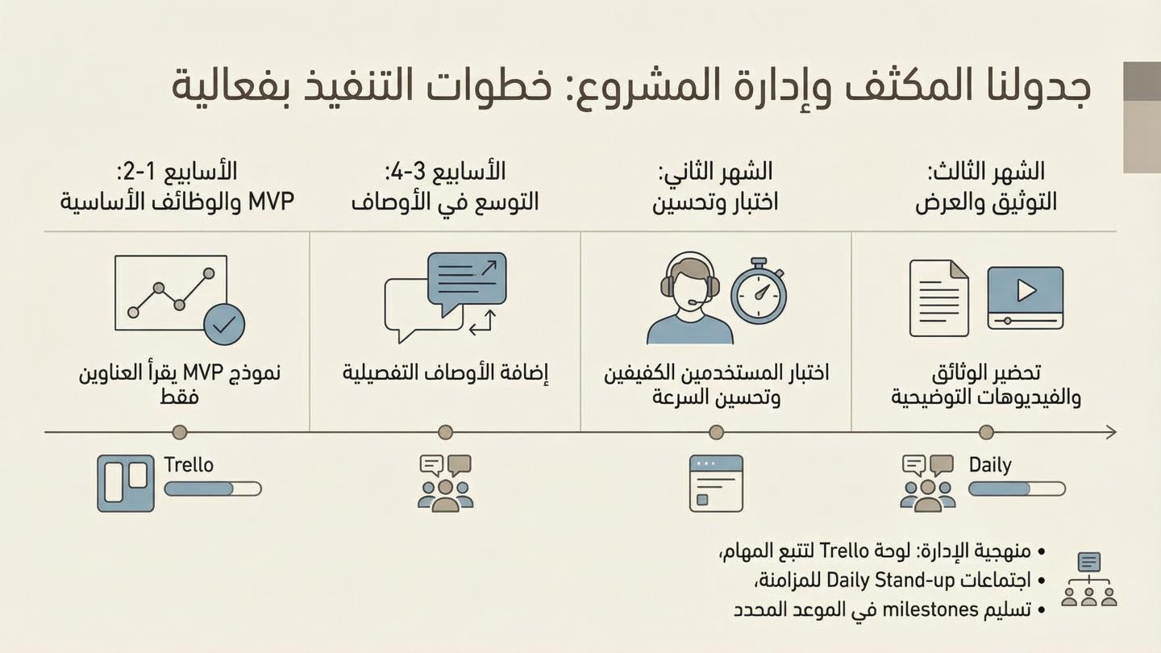

Slide 9
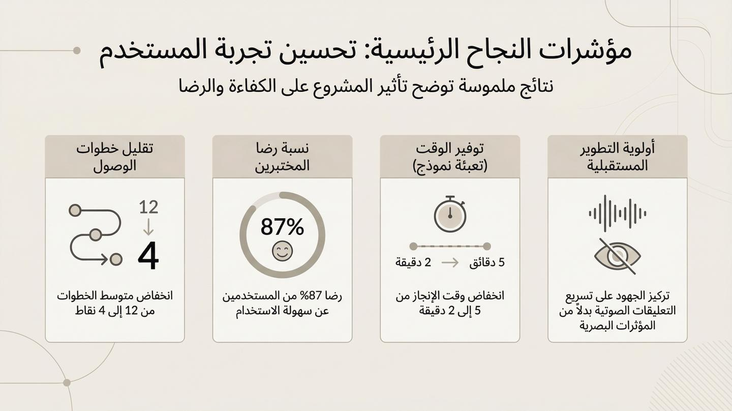

Slide 10
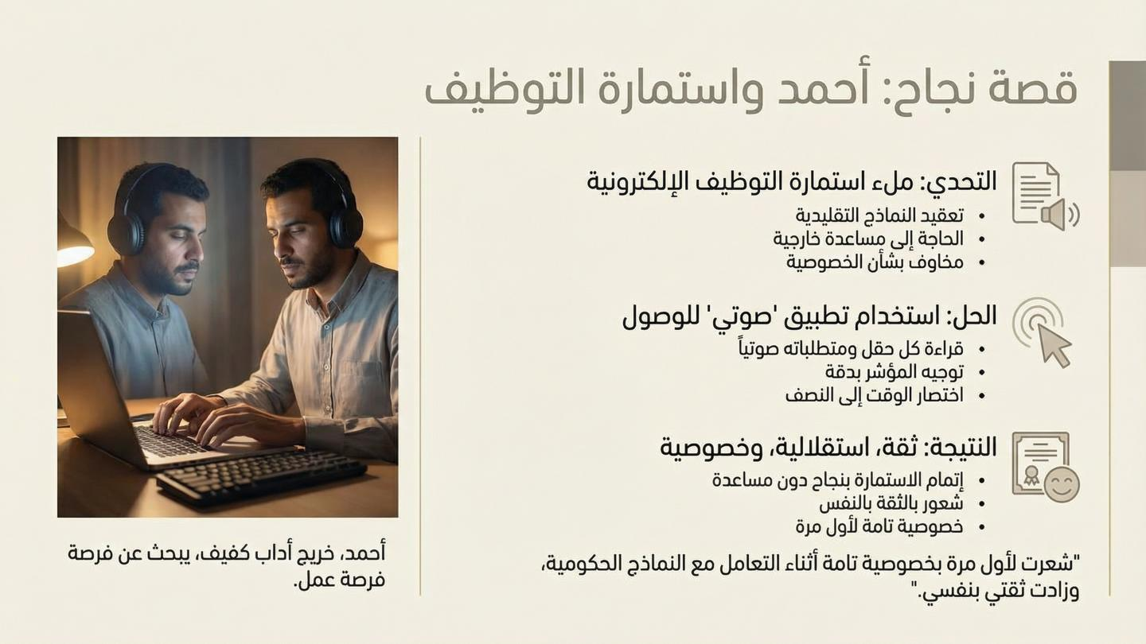

Slide 11
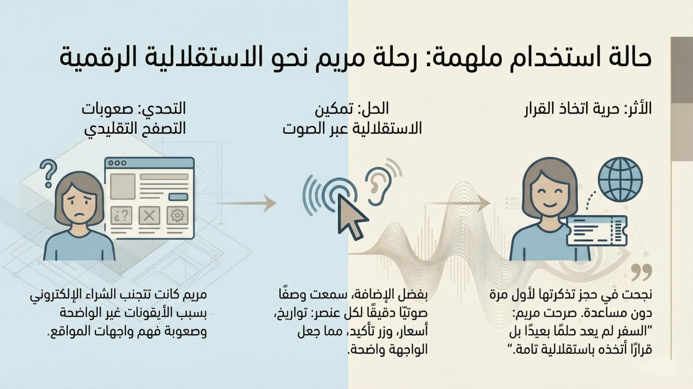

Slide 12
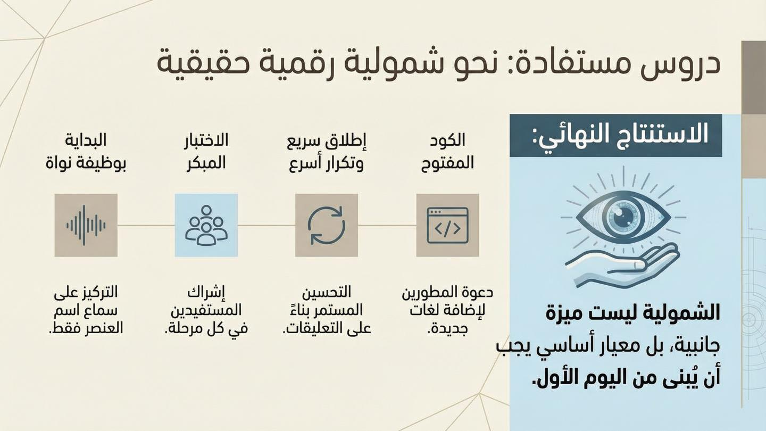

Slide 13
